Slide 1

Impact of Marketing Strategies on Sales
John Lalremruata
Brindavan college
Mca (bcu)

Slide 2
Outline:
Title
Objective
Problem Statement
Proposed Solution
Short video
Implementation
Output Screenshots
References
Thank you

Slide 3
Abstract
* Objective: The study aims to analyze how marketing campaigns impact sales by leveraging historical sales data.
* Goal: To provide insights into the influence of marketing strategies on sales performance, improving future business decisions.

Slide 4
Problem Statement
* Challenges: In today’s competitive business environment, companies struggle to quantify the effectiveness of marketing strategies.
* Impact: Lack of clarity can lead to resource misallocation, missed sales opportunities, and hinder overall business growth.

Slide 5
Proposed Solution
*Data-Driven Approach: Use Python to analyze sales data before and after marketing campaigns.
*Benefits:
Data Processing – Clean and analyze historical sales data.
Visualization – Create visual representations to highlight the impact of marketing efforts.
Informed Decisions – Help business refine marketing strategies for better sales outcomes.

Slide 6
Short Video
https://shorturl.at/UX5pP

Slide 7
Implementation
*GitHub Link: I provided the GitHub repository link containing the Python code and any other necessary files for the project.
*Description: I also briefly explain the structure of the code and how it processes and visualizes sales data.

Slide 8
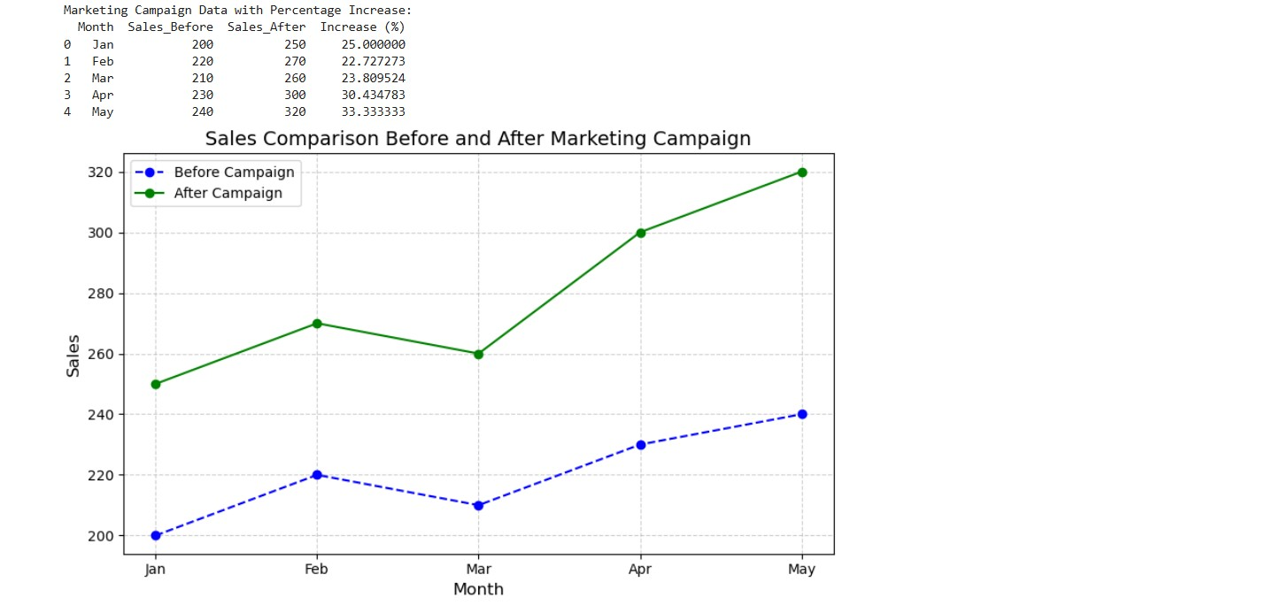
Output Screenshots

Slide 9
References
*Books – “Python for Data Analysis” by Wes McKinney.
*Websites – Kaggle, HubSpot Blog.
*Tools – Python 3, Anaconda, Windows.

Slide 10
THANK YOU
- John Lalremruata

